Slide 1
B09S0061 Software Engineering
Lecture 8
Instructor: Liu, Guangchi Ph.D.
2025/04/18
Notes:
本模板基于“中国科学院大学-路人丁-PPT模板”魔改而成，著作权归该作者所有。
本模板中使用的东南大学校徽、校标文字组合、校训文字等素材来自于微信公众号“金木屋”。
本模板的视觉设计参考了“东南大学视觉识别系统”。
人物介绍页头像素材来自 小肥柴。
本模板力求简洁，布局合理，主次分明。以学术风为设计理念，适用于学术报告与论文答辩等相关应用场景。模板未使用任何动画效果。
您仅可以以个人非商业用途使用本PPT模板，不可将信息内容的全部或部分用以出售，或以出租、出借、转让、分销、发布等其他任何方式供其他人使用。
欢迎 持续关注东南大学止于至善学术风 PPT 模板 （https://zhuanlan.zhihu.com/p/335298500）后续的功能优化及多语言更新版本。
最后，祝汇报顺利，马到成功！
Version: (2021) v1.5-en.

Slide 2
Heads Up
2nd Assignment Due: Apr 21th (Monday), 23:55 pm

Slide 3
Heads Up
2nd Lab: Apr 26th (Saturday), 14:00 – 17:25, J6-101 (Lecture Classroom)
Each team will take your laptop and present to TA or Instructor:
User Experience Design
System Architecture
Specific design for security
Specific design for performance

Slide 4
Heads Up
Prepare the following questions (10 pts for each question )
Q1 Have your designed any paper prototype/wireframe/mock-up/operational prototype for the frontend of your project ?
Q2 What are the MVC components (if any) of your frontend?
Q3 What is your plan for evaluating/testing the user experience of your project?
Q4 What is the component diagram of your project like?
Q5 What is the deployment diagram of your project like?
Q6 What is the package diagram of your project like?
Q7 Any plan of using virtualization technologies?
Q8 Any possible security risk in your project? How will you minimize them?
Q9 What will the peak demand/capacity of your product be in the future?
Q10 Based on the potential demand/capacity, any performance bottleneck in your project? How will you improve them?

Slide 5
Requirements on Final Project
9. Show the component/deployment diagram of your project
10. Describe the security mechanism used in your project

Slide 6
01
PART ONE
Performance

Slide 7
Performance of Computer Systems
Yet performance is important
A single bottleneck can slow down an entire system
Future loads may be much greater than predicted

Slide 8
When Performance Matters
Real time systems when computation must be fast enough to support the service provided, e.g., fly-by wire control systems have tight response time requirements.
Very large computations where elapsed time may be measured in days, e.g., calculation of weather forecasts must be fast enough for the forecasts to be useful.
User interfaces where humans have high expectations, e.g., mouse tracking must appear instantaneous.
Transaction processing where staff need to be productive and customers not annoyed by delays, e.g., High Frequency Trading
Resource constrained systems where small devices still need to do big things

Slide 9
High-Performance Computing
High-performance computing:
Large data collections with many transactions (e.g., Taobao)
Huge numbers of users (e.g., TikTok)
Large computations (e.g., LLM)

Slide 10
Performance Challenges for all Software Systems
Tasks
Predict performance problems before a system is implemented.
Design and build a system that is not vulnerable to performance problems.
Identify causes and fix problems after a system is implemented.

Slide 11
Performance Challenges for all Software Systems
Basic tactics
Understand how the underlying hardware and networks components interact with the software when executing the system.
For each subsystem calculate the capacity and load. The capacity is a combination of the hardware and the software architecture.
Identify subsystems where the load is near peak capacity.
Example
Calculations indicate that the capacity of a search system is 1,000 searches per second. What is the anticipated peak demand?

Slide 12
Interactions between Hardware and Software
Examples
In a distributed system, what messages pass between nodes?
How many times must the system read from disk for a single transaction?
What buffering and caching is used?
Are operations in parallel or sequential?
Are other systems competing for a shared resource (e.g., a network or server farm)?
How does the operating system schedule tasks?

Slide 13
Look for Bottlenecks: CPU Performance
CPU performance is a limiting constraint in certain domains, e.g.:
large data analysis (e.g., searching)
mathematical computation (e.g., feature engineering)
compression and encryption
multimedia (e.g., video)
perception (e.g., image processing)

Slide 14
Look for Bottlenecks
BUT, CPU performance is usually not the limiting factor, as multi-core machines are common today
Hardware bottlenecks
Reading data from disk
Shortage of memory (including paging)
Moving data from memory to CPU
Network capacity
Inefficient software
Algorithms that do not scale well (e.g., in legacy systems)
Parallel and sequential processing (multiprocess vs. multithread)

Slide 15
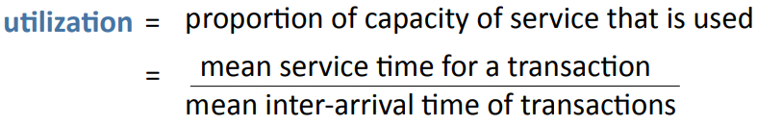
Look for Bottlenecks: Utilization
Utilization is the proportion of the capacity of a service that is used on average.
When the utilization of any hardware component exceeds 0.3, be prepared for congestion.
Peak loads and temporary increases in demand can be much greater than the average.

Slide 16
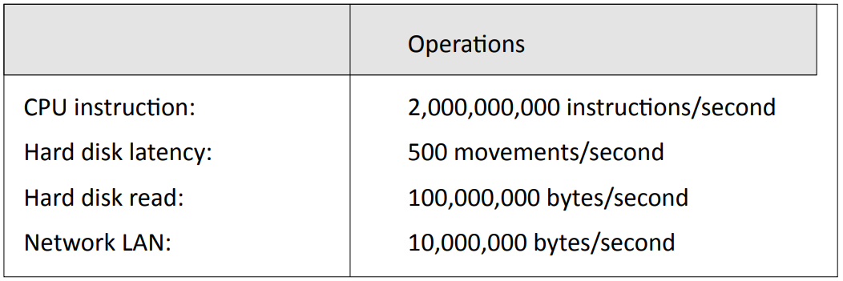
Timescale of Different Components
Multiprocess or Multithread?
Actual performance may be considerably less than the theoretical peak

Slide 17
Predicting System Performance
Direct measurement on subsystem (benchmark)
Mathematical models (queueing theory)
Simulation
All require detailed understanding of the interaction between software and hardware systems.

Slide 18
Mathematical Models
Queueing theory
Good estimates of congestion can be made for single-server queues with:
Arrivals that are independent, random events (Poisson process)
Service times that follow families of distributions (e.g., negative exponential, gamma)
Many of the results can be extended to multi-server queues.
Much of the early work in queueing theory by Erlang was to model congestion in telephone networks.

Slide 19
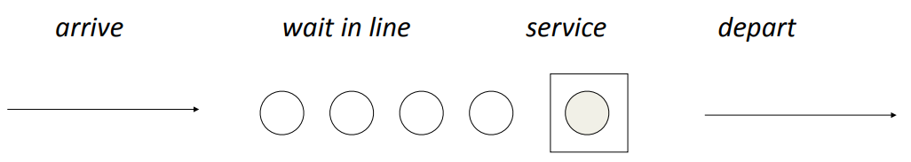
Mathematical Models: Queues
Single server queue
Examples
Requests to read from a disk (with no buffering or other optimization)
Customers waiting for check in at an airport, with a single check-in desk

Slide 20
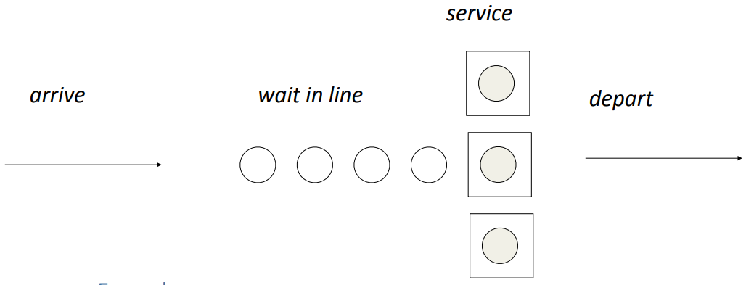
Queues
Multi-server queue
Examples
Tasks being processed on a computer with several processors
Customers waiting for check in at an airport, with several check-in desks

Slide 21
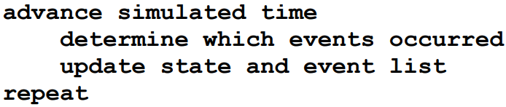
Techniques: Simulation
Build a computer program that models the system as set of states and events.
Discrete time simulation: Time is advanced in fixed steps (e.g., 1 millisecond)
Next event simulation: Time is advanced to next event
Events can be simulated by random variables (e.g., arrival of next customer, completion of disk latency), or by using data collected from an operational system.

Slide 22
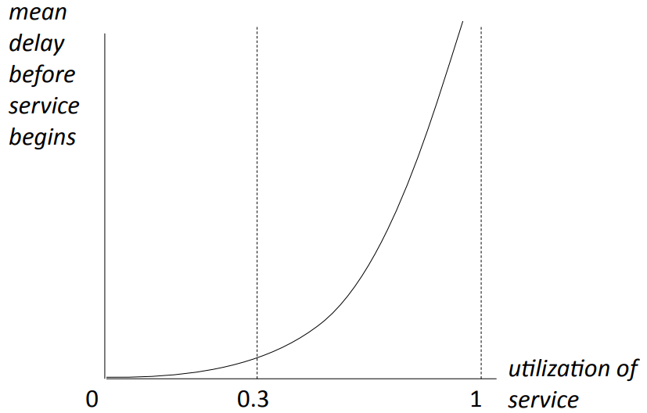
Behavior of Queues: Utilization
The exact shape of the curve depends on the type of queue (e.g., single server) and the statistical distributions of arrival times and service times.

Slide 23
Measurements on Operational Systems
Measurements on operational systems
Benchmarks: Run system on standard problem sets, sample inputs, or a simulated load on the system.
Instrumentation: Clock specific events.
If you have any doubt about the performance of part of a system, experiment with a simulated load.

Slide 24
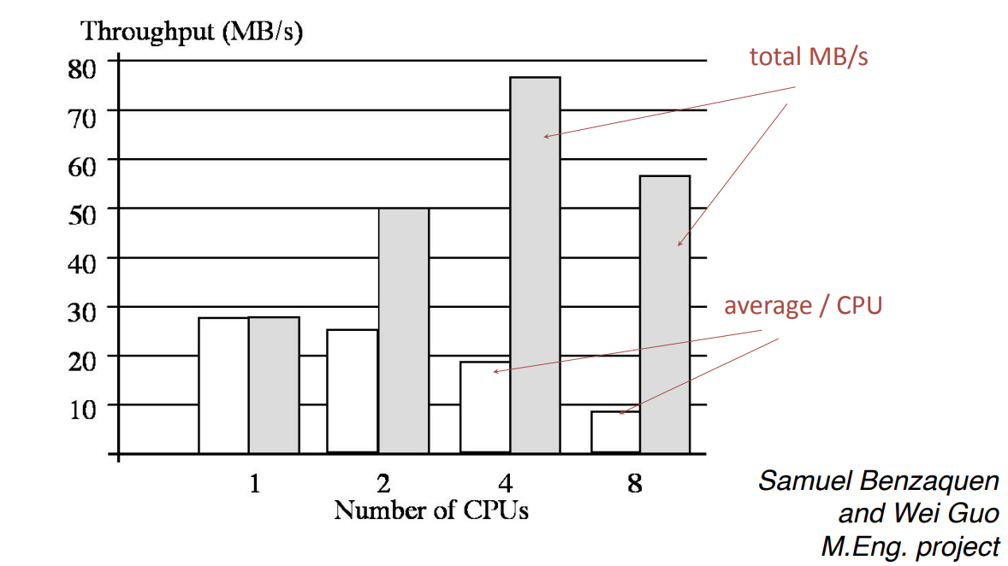
Example: Web Laboratory
Benchmark: throughput v. number of CPUs on a symmetric multiprocessor

Slide 25
Fixing Bad Performance
If a system performs badly, begin by identifying the cause:
Instrumentation. Add timers to the code. Often this will reveal that delays are centered in a specific part of the system.
Test loads. Run the system with varying loads, e.g., high transaction rates, large input files, many users, etc. This may reveal the characteristics of when the system runs badly.
Design and code reviews. Team review of system design, program design, and suspect sections of code. This may reveal an algorithm that is running very slowly, e.g., a sort, locking procedure, etc.
Hands-on linux command line: htop, ifhtop, nvidia-smi, etc….

Slide 26
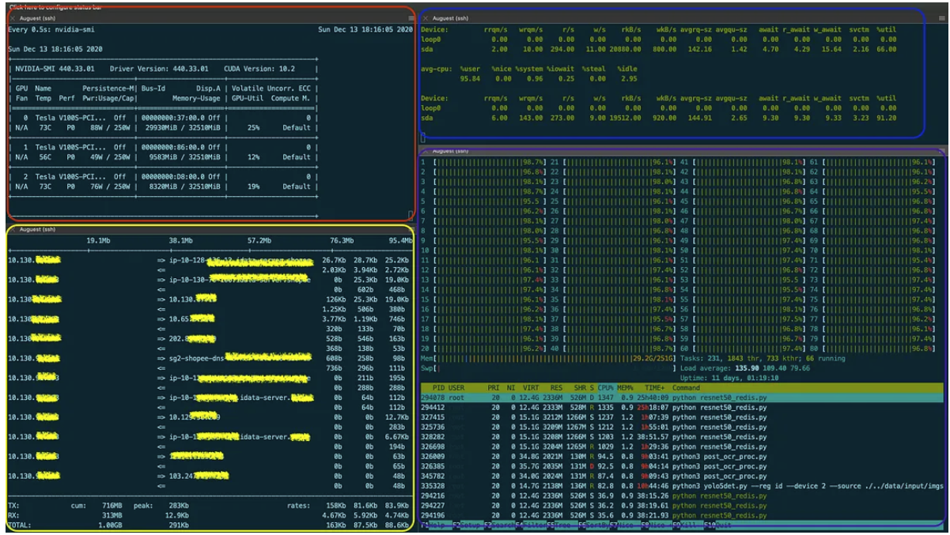
Fixing Bad Performance

Slide 27
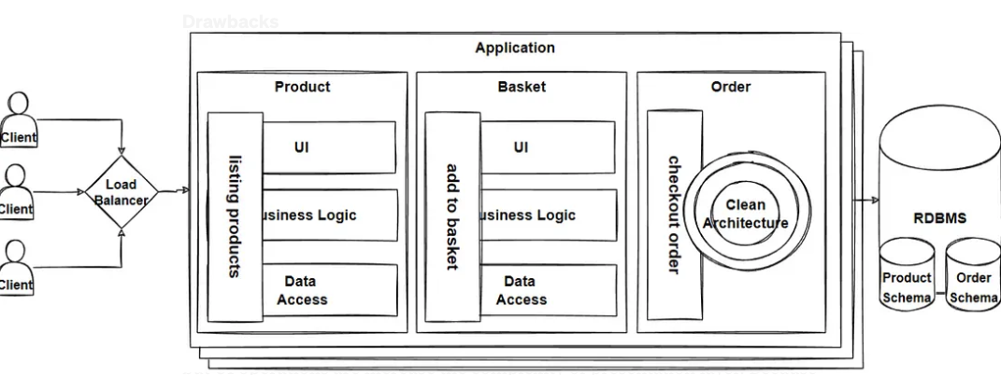
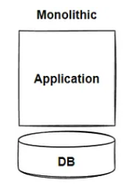
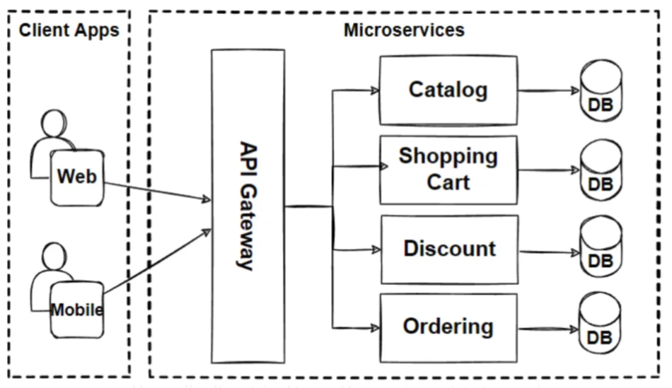
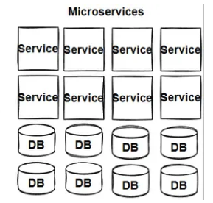
Improving Performance
Special purpose hardware
Graphics processors (e.g., Nvidia)
Algorithm/data structure design
Time/Space Complexity
Special Database/Data warehouse
Hive, ClickHouse
Parallel processing
Spark, Kubernetes (K8s)

Slide 28
Thoughts for the Future
Current trends in high performance computing
High performance applications require ever increasing parallel computing, cluster computing, and cloud computing.
The performance of networks is critical — both the throughput and the latency.
Data centers are becoming huge and extremely complex.
Software developers
Distributed, parallel infrastructure (Spark, Hadoop).
Large Language Model

Slide 29
02
PART Two
Models for Program Design

Slide 30
Approaches to Program Development
Heavyweight approach
Program design and coding are separate.
The design uses class models and other models to specify the program in detail, before beginning to code. UML is a good modeling language for this purpose.
Lightweight approach
The program design and coding are interwoven.
The development is iterative, using an Integrated development environment (IDE).
Mixed approach
Outline design is created using models, with details worked out iteratively during coding.

Slide 31
Program Design
The task of program design is to represent the software architecture in a form that can be implemented as one or more executable programs.
Given a system architecture, the program design specifies:
programs, components, packages, classes, class hierarchies, etc.
interfaces, protocols (where not part of the system architecture)
algorithms, data structures, security mechanisms, operational procedures

Slide 32
UML Models
UML models (diagrams and specifications) can be used for almost all aspects of program design.
Diagrams give a general overview of the design, showing the principal elements and how they relate to each other.
Specifications provide details about each element of the design.
In heavyweight software development processes, the specifications should have sufficient detail that they can be used to write code from. The goal is to complete the entire specification before coding begins.

Slide 33
UML Models
Models used mainly for requirements
Use case diagram shows a set of use cases and actors, and their relationships.
Models used mainly for systems architecture
Component diagram shows the organization and dependencies among a set of components.
Deployment diagram shows the configuration of processing nodes and the components that live on them.
Models used mainly for program design
Class diagram shows a set of classes, interfaces, and collaborations with their relationships.
Object diagram or sequence diagram show a set of objects and their relationships.

Slide 34
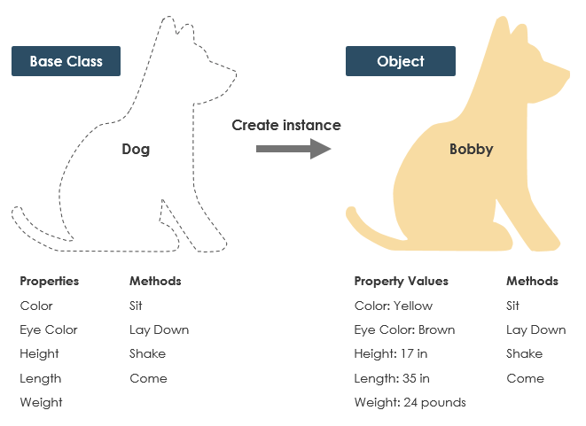
Class vs. Object

Slide 35
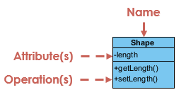
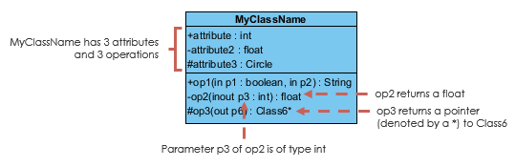
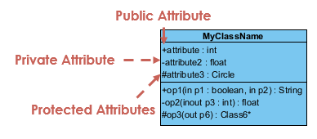
Class Diagram
A class is a description of a set of objects that share the same attributes, methods, relationships, and semantics.
Note on terminology. Operations is like methods in Java, Python, etc.

Slide 36
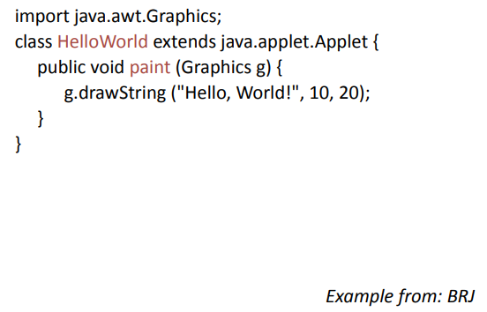
The "Hello, World!" Applet

Slide 37
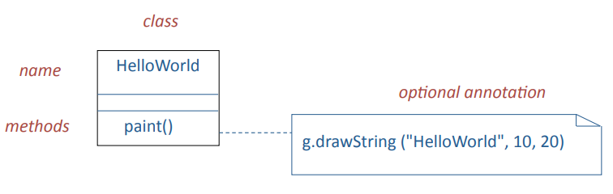
The HelloWorld Class

Slide 38
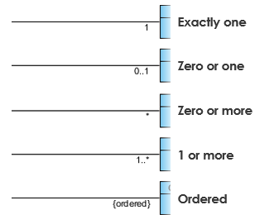
Association
A structural link between two peer classes if there is an association between Class1 and Class2

Slide 39
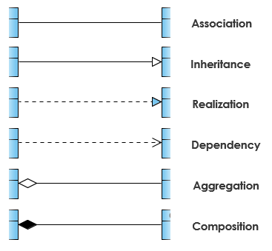
Notation: Relationships

Slide 40
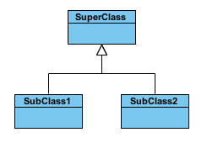
Generalization/Inheritance
A generalization is a taxonomic relationship between a more general class and a more specific class. Each instance of the specific classifier is also an indirect instance of the general class. Thus, the specific class inherits the features of the more general class.

Slide 41


Aggregation/Composition
Aggregation is a special type of association which represents a "part of" relationship.
Class2 is part of Class1.
Many instances (denoted by the *) of Class2 can be associated with Class1.
Objects of Class1 and Class2 have separate lifetimes.
Composition is a special type of aggregation where parts are destroyed when the whole is destroyed.
Objects of Class2 live and die with Class1
Class2 cannot stand by itself.

Slide 42


Dependency
An object of one class might use an object of another class in the code of a method. If the object is not stored in any field, then this is modeled as a dependency relationship
A special type of association
Exists between two classes if changes to the definition of one may cause changes to the other (but not the other way around)

Slide 43
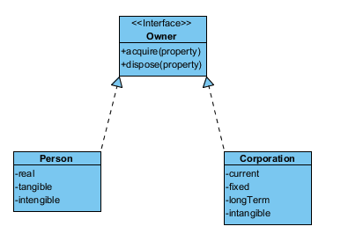
Realization
Realization is a relationship between the blueprint class and the object containing its respective implementation level details. This object is said to realize the blueprint class.

Slide 44
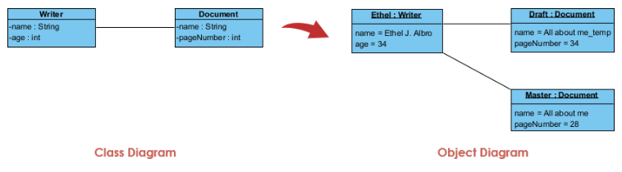
Object Diagram

Slide 45
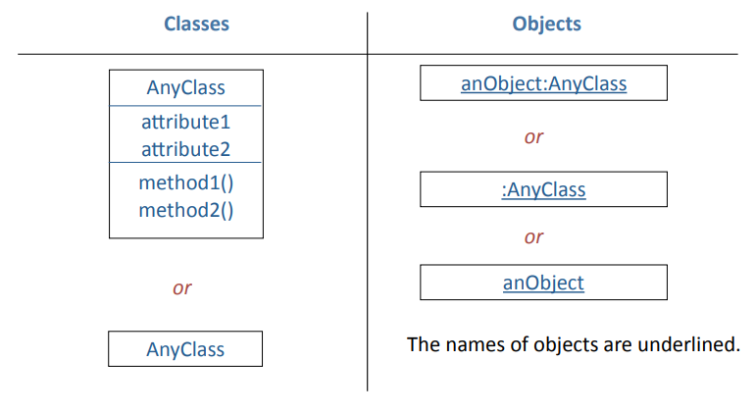
UML Notation for Classes and Objects

Slide 46
Deciding which Classes to Use
Given a real-life system, how do you decide what classes to use?
Step 1. Identify a set of candidate classes that represent the system design.
What terms do the users and implementers use to describe the system? These terms are candidates for classes.
Is each candidate class crisply defined?
For each class, what is its set of responsibilities? Are the responsibilities evenly balanced among the classes?
What attributes and methods does each class need to carry out its responsibilities?

Slide 47
Deciding which Classes to Use
Step 2. Modify the set of classes
Goals:
Improve the clarity of the design
If the purpose of each class is clear, with easily understood methods and relationships, developers are likely to write simple code, which future maintainers can understand and modify.
Increase coherence within classes, and lower coupling between classes.
Aim for high cohesion within classes and weak coupling between them.

Slide 48
Application Classes and Solution Classes
A good design is often a combination of application classes and solution classes.
Application classes represent application concepts.
Noun identification is an effective technique to generate candidate application classes.
Solution classes represent system concepts, e.g., user interface objects, databases, etc.

Slide 49
Noun Identification: a Library Example
The library contains books and journals. It may have several copies of a given book. Some of the books are reserved for short-term loans only. All others may be borrowed by any library member for three weeks. Members of the library can normally borrow up to six items at a time, but members of staff may borrow up to 12 items at one time. Only members of staff may borrow journals.
The system must keep track of when books and journals are borrowed and returned, and enforce the rules.

Slide 50
Noun Identification: a Library Example
The library contains books and journals. It may have several copies of a given book. Some of the books are reserved for short-term loans only. All others may be borrowed by any library member for three weeks.
Members of the library can normally borrow up to six items at a time, but members of staff may borrow up to 12 items at one time. Only members of staff may borrow journals.
The system must keep track of when books and journals are borrowed and returned, and enforce the rules.

Slide 51
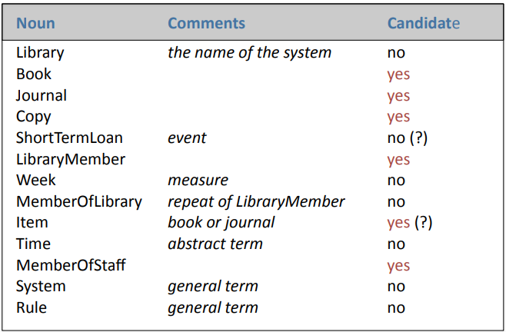
Candidate Classes

Slide 52
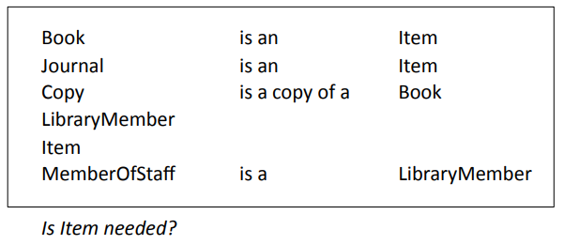
Relations between Classes

Slide 53
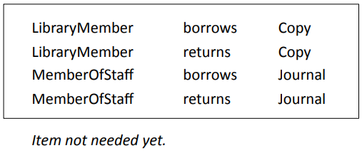
Methods

Slide 54
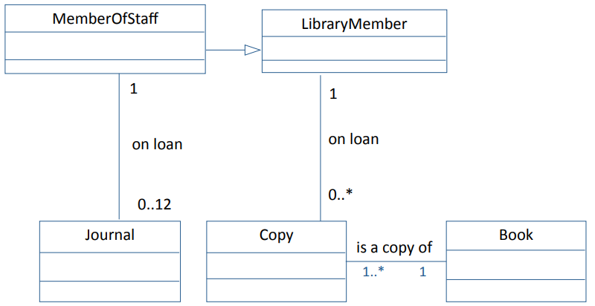
A Possible Class Diagram

Slide 55
From Candidate Classes to Completed Design
Methods used to move to final design
Reuse: Wherever possible use existing components, or class libraries. They may need extensions.
Restructuring: Change the design to improve understandability, maintainability, etc. Techniques include merging similar classes, splitting complex classes, etc.
Optimization: Ensure that the system meets anticipated performance requirements, e.g., by changed algorithms or restructuring.
Completion: Fill all gaps, specify interfaces, etc.
Design is iterative
As the process moves from preliminary design to specification, implementation, and testing it is common to find weaknesses in the program design. Be prepared to make major modifications.

Slide 56
Modeling Dynamic Aspects of Systems
Interaction diagram: shows set of objects and their relationships including messages that may be dispatched among them.
• Sequence diagrams: time ordering of messages

Slide 57
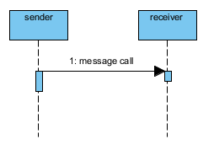
Synchronous Message
A synchronous message (typically an operation call) is shown as a solid line with a filled arrowhead. It is a regular message call used for normal communication between sender and receiver.

Slide 58
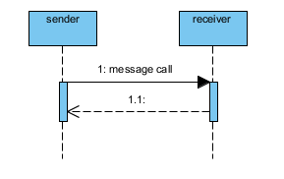
Return Message
A return message uses a dashed line with an open arrowhead.

Slide 59
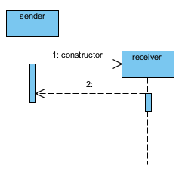
Constructor Message
A constructor message creates its receiver. The sender that already exist at the start of the interaction are placed at the top of the diagram. Targets that are created during the interaction by a constructor call are automatically placed further down the diagram

Slide 60
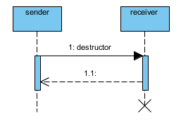
Destructor Message
A destructor message destroys its receiver. There are other ways to indicate that a target is destroyed during an interaction. Only when a target's destruction is set to 'after destructor' do you have to use a destructor.

Slide 61
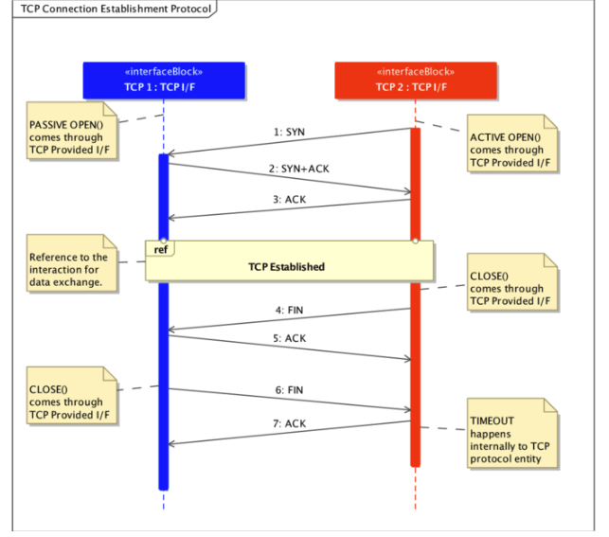
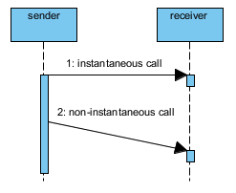
Non instantaneous Message
Messages are often considered to be instantaneous, thus, the time it takes to arrive at the receiver is negligible. The messages are drawn as a horizontal arrow. To indicate that it takes a certain while before the receiver actually receives a message, a slanted arrow is used.

Slide 62
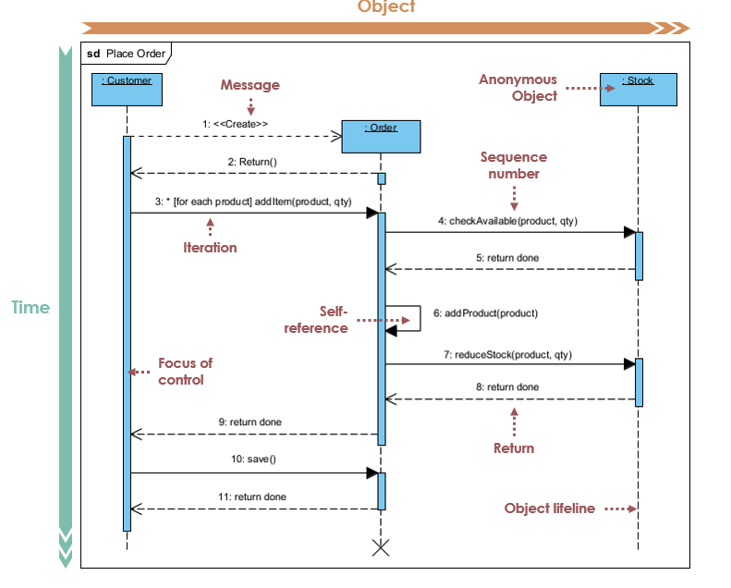
Sequence Diagram
Trading System: a Customer place Orders for products in Stock.
Step 1 - 2: Customer creates an order
Step 3: Customer add items to the order
Step 4 - 5: Each item is checked for availability
in inventory.
Step 6 - 8 : If the product is available, it is added
to the order.
Step 9 return
Step 10 - 11: save and destroy order

Slide 63
03
PART THREE
Program Development

Slide 64
Integrated Development Environments
Basic software development requires:
text editor (e.g., vi editor for Linux)
compiler for individual files
build system (e.g., make for Linux)
Integrated development environments combine:
source code editor
incremental compiler
build automation tools
a debugger
and much, much more

Slide 65
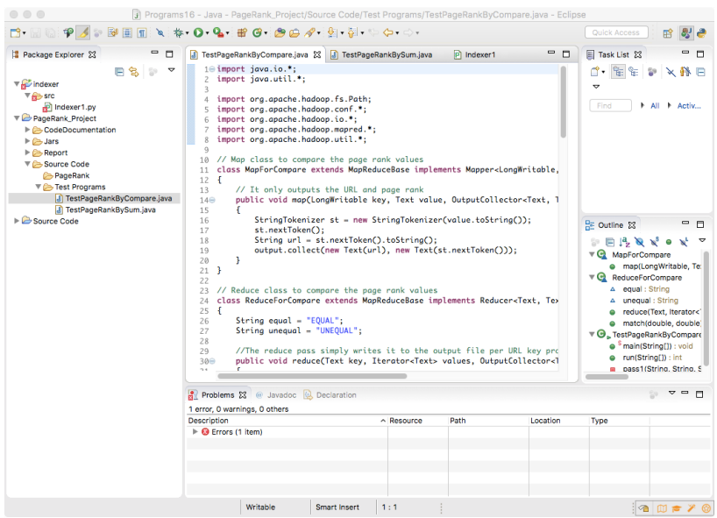
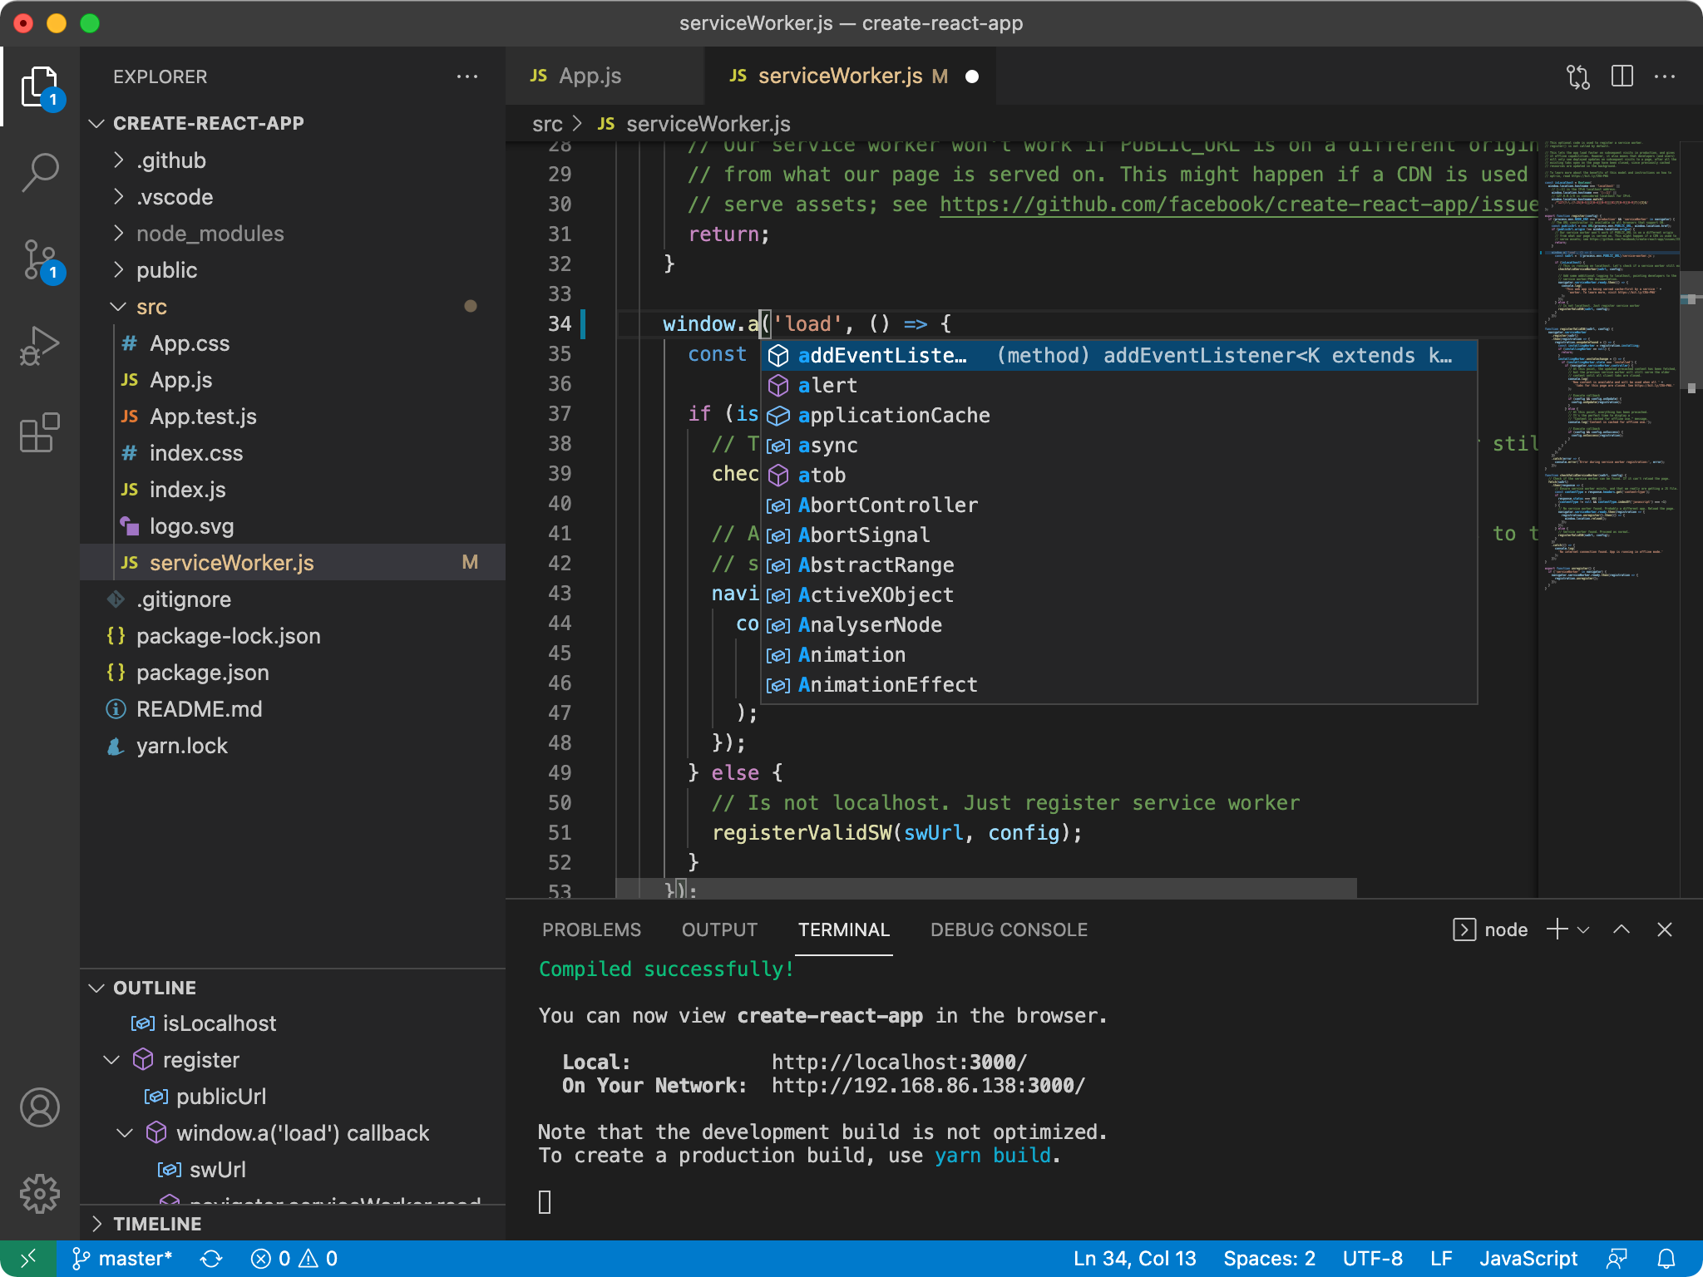

Slide 66
Integrated Development Environment
An IDE provides:
source code editor
debugger
incremental compiler
programming documentation
build automation tools
version control
Auto code generation
Much more is available via plug-ins.

Slide 67
Program Design: Integrated Development Environment
Integrated development environments provide little help in designing (NOT coding!) a program
They assume that you have already have a design:
classes
methods
data structures
interfaces
Options for program design:
program design using modeling tools, such as UML
design while coding: design — code — redesign loop (small programs only)
existing frameworks
advanced environments that combine frameworks and development tools
It is often good to combine aspects of these different approaches.

Slide 68
The Design — Code — Redesign Loop
If the class structure is straightforward it may be possible to use the integrated development environment to:
create an outline of the class structure and interfaces
write code
modify the class structure as needed and rework the code as necessary
This is only possible with small teams with close communication.
The maximum size of program depends on experience of programmer(s) and complexity of the program.
It may be possible to complete a single agile sprint.
Eventually the amount of rework becomes overwhelming.

Slide 69
Class Hierarchies
Since the design of class hierarchies is difficult it is good practice to use existing frameworks.
Often many of the classes will have been written for you, or abstract classes are provided that you can use as a basis for your own subclasses.
Examples:
class hierarchies that are part of programming languages
toolkits (e.g., for graphical user interfaces)
design patterns
frameworks for web development and mobile apps

Slide 70
Class Hierarchies: Programming Languages
Example: Java
Java is a relatively straightforward language with a very rich set of class hierarchies.
Java programs derive much of their functionality from standard classes.
Learning and understanding the classes is difficult.
Experienced Java programmers can write complex systems quickly.
Inexperienced Java programmers write inelegant and buggy programs.
Languages such as Java and Python steadily change their class hierarchies over time. Commonly the changes replace special purpose functionality with more general frameworks.
If you design your programs to use the class hierarchies in the style intended by the language developers, it is likely to help with long term maintenance.

Slide 71
Advanced Development Environments
Application frameworks can be used with any program development environment, e.g., Django and Eclipse (Python version)
An advanced development environment combines:
integrated development environment (IDE)
application framework
user interface layout manager
and more
Example:
Apple’s Xcode for iOS

Slide 72
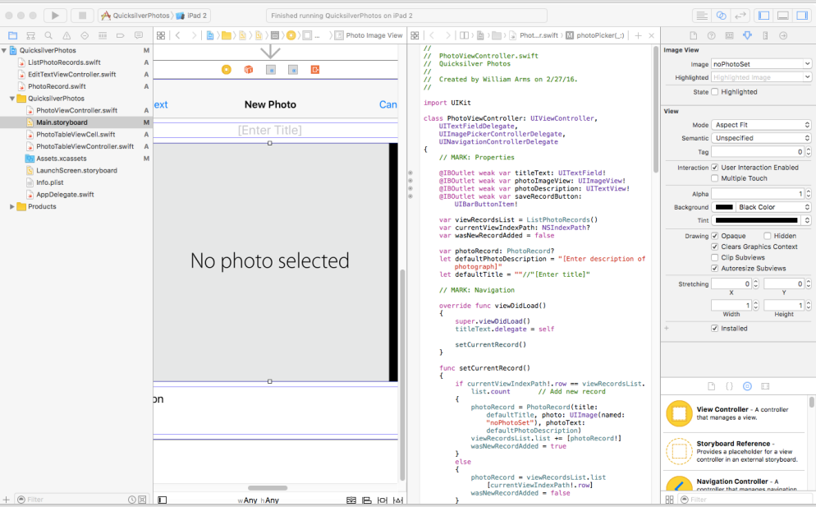

Slide 73
Advanced Development Environments
An advanced development environment is intended to provide everything that a developer needs.
The developer is expected to follow the program choices that are provided.
For example, when Xcode is used with iOS it has a very specific purpose: mobile apps for Apple devices such as iPhones, iPads.
Special programming language (Swift or Objective C)
MVC framework
If you accept the overall program design it is very powerful:
Auto layout of graphical interfaces
Comprehensive set of classes for user interfaces and navigation
Simulators for all Apple devices

Slide 74
Using Development Frameworks
Development frameworks are powerful and flexible.
If your application fits the framework, they do much of the program design and provide high quality code for many of the standard parts of any application.
Some parts of the application may need be designed separately.
But beware:
You are forced to build your application within the framework that is provided.
The frameworks are continually modified.
These frameworks are complex and take a long time to learn.

Slide 75
Production Programming
Murphy's Law:
If anything can go wrong, it will.
Challenges:
Code has to be maintained over the long term, with different system software.
Interfaces will be used in new and unexpected ways.
Every possible error will eventually occur at the worst possible time (bad data, failures of hardware and system software).
There are likely to be security attacks.

Slide 76
Production Programming
Robust programming:
Write simple code.
Avoid risky programming constructs.
If code is difficult to read, rewrite it.
Incorporate redundant code to check system state after modifications.
Test implicit assumptions explicitly, e.g., check all parameters received from other routines.
Eliminate all warnings from source code.
Have a thorough set of test cases for all your code.
In a production environment, expect to spend longer on coding and tesMng than in an academic setting.

Slide 77
Thanks for your listening!
Instructor: Liu, Guangchi Ph.D.
2025/02/28

